Slide 1
Object Oriented Analysis
Identifying Use cases
Object Analysis: Classification
Identifying object relationships, Attributes and Methods.

Slide 2
Identifying the use cases: Goals
The use-case approach to object-oriented
analysis and the object-oriented analysis
process.
Identifying actors.
Identifying use cases.
Documentation.

Slide 3
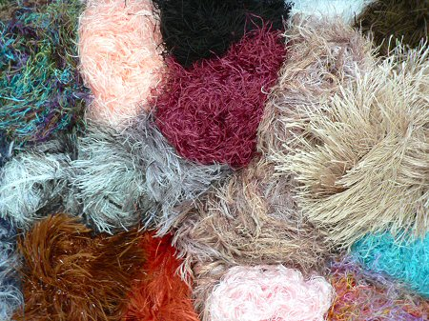
What Is Analysis?
Analysis is the process of transforming
a problem definition from a fuzzy set of
facts and myths into a coherent
statement of a system’s requirements.
Notes:
Fuzzy = difficult to perceive; indistinct or vague
Coherent = forming a unified whole.

Slide 4
Analysis (contd..)
The main objective of the analysis is to capture:
  a complete, unambiguous, and consistent picture of the requirements of the system and
  what the system must do to satisfy the users' requirements and needs.

Slide 5
Where Should We Start?
1. Examination of existing system documentation.
2. Interviews.
3. Questionnaire.
4. Observation.

Slide 6
Requirements Difficulties
Three most common sources of requirements difficulties are:
1. Incomplete requirements.
2. Fuzzy descriptions (such as fast response).
3. Unneeded features.

Slide 7
Use-Case Driven Object-Oriented
Analysis: The Unified Approach
The OOA phase of the UA uses the following to describe the system.
  Actors-external factors interact with the system
  Usecases-scenarios that describe how actors use the system

Slide 8
The Object-Oriented Analysis
(OOA) Process
The process consists of the following steps:
1. Identify the actors:
– Who is using the system?
– Or, in the case of a new system, who will be using system?

Slide 9
The OOA Process (Con’t)
2. Develop a simple business process model using UML activity diagram.
Activity diagrams are graphical representations of workflows of stepwise activities and actions with support for choice, iteration and concurrency.
In the Unified Modeling Language, activity diagrams can be used to describe the business and operational step-by-step workflows of components in a system.
An activity diagram shows the overall flow of control

Slide 10
The OOA Process (Con’t)
3. Develop the use case:
What the users are doing with the system?
Or, in the case of a new system, what users will be doing with the system?
Use cases provide us with comprehensive
documentation of the system under study.

Slide 11
The OOA Process (Con’t)
4. Prepare interaction diagrams:
  Determine the sequence.
  Develop collaboration diagrams.

Slide 12
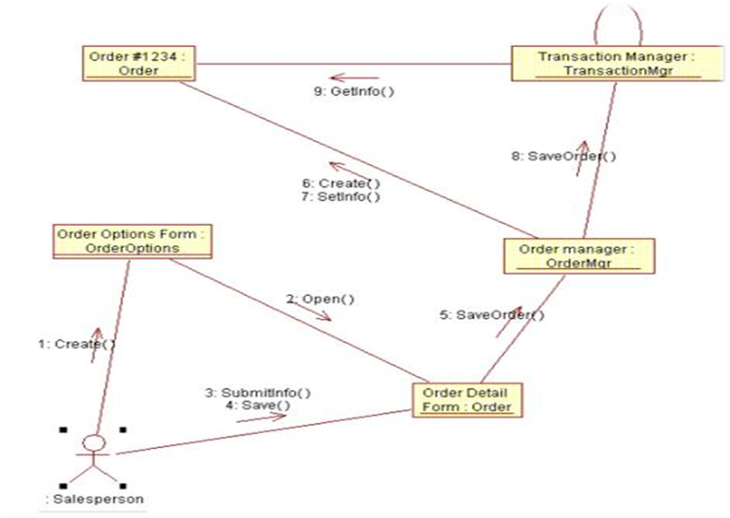

Slide 13
The OOA Process (Con’t)
5. Classification—develop a static UML class diagram:
  Identify classes.
  Identify relationships.
  Identify attributes.
  Identify methods.

Slide 14
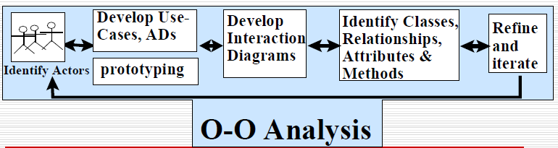
The OOA Process (Con’t)
6. Iterate and refine: If needed, repeat the preceding steps.

Slide 15
Use Case Model
Use cases are scenarios for understanding system requirements.
Use case defines what happens in the system when a use case is performed.
The use-case model tries to systematically identify uses of the system and therefore the system's responsibilities.

Slide 16
Use Cases Under the
Microscope
"A Use Case is a sequence of transactions in a system whose task is to produce results of measurable value to an individual actor of the system."

Slide 17
Use Case Key Concepts
Use case Use case is a special flow of events through the system.
Actors An actor is a user playing a role with respect to the system.
In a system This simply means that the actors communicate with the system's use case

Slide 18
Use Case Key Concepts (Con’t)
Measurable value A use case must
help the actor to perform a task that has
some detectable value.
Transaction A transaction is an atomic set of activities that are performed either fully or not at all.

Slide 19
Use Associations
The use case association occurs when you
are describing your use cases and
notice that some of them have common
subflows.
The use association allows you to
extract the common subflow and make
it a use case of its own.

Slide 20
Extends Associations
The extends association is used when
you have one use case that is similar to
another use case but does a bit more or
Is more specialized; in essence, it is like a subclass

Slide 21
Types of Use Cases
Essential Use Cases are expressed in an ideal form that remains relatively free of technology and implementation details; design decisions are deferred and abstracted, especially those related to the user interface.
Concrete or Real Use Case concretely describes the process in terms of its real current design, committed to specific input and output technologies and so on.

Slide 22
Types of Use Cases
Abstract Use Case is not complete and has no actor that initiates it but is used by another use cases.

Slide 23
IDENTIFYING THE ACTORS
The term actor represents the role a user plays with respect to the system.
When dealing with actors, it is important to think about roles rather than people or job titles.
The actors is as important as identifying classes, structures, associations, attributes and behavior.

Slide 24
IDENTIFYING THE ACTORS
Actors can be found through the answers to the following questions.
Who is using the system ?. or,
Who affected by the system? Or,
Which groups need help from the system to perform a task?.
Who affects the system? Or ,

Slide 25
IDENTIFYING THE ACTORS
Which user groups are needed by the system to perform its functions?. These functions can be both main functions and secondary function such as administration.
Which external hardware or other systems use the system to perform task?.
What problems does this application solve?.
How do users use the system(use case)?What are they doing with the system

Slide 26
GUIDELINES FOR FINDING THE USECASES
1. For each actor, find the tasks and functions that the actor should be able to perform. The use case should represent a course of events that leads to a clear goal.
2. Name the use cases
3. Describe the use case briefly by applying terms with which the user is familiar .this makes the description less ambiguous.

Slide 27
Dividing Use cases Into Packages
Use case represents a particular scenario in the system.
A design is broken down into packages.
EX::In a library system, the various scenarios involve a supplier providing books or a member doing research or borrowing books, Do research and purchase books

Slide 28
DEVELOPING EFFECTIVE DOCUMENTATION
A document can serve as a communication vehicle among the project’s team members, or it can serve as an initial understanding of the requirements.
In many projects, documentation can be an important factor in making a decision about committing resources.

Slide 29
Organization Conventions For Documentation
The documentation depends on the organization’s rules and regulations.
Too little documentation invites disaster
Too much documentation, transfers energy from the problem solving tasks to a mechanical and unrewarding activity.

Slide 30
Guidelines for developing Effective documentation
Common cover
80-20 rule
Familiar vocabulary
Make the documentation as short as possible
Organize the document

Slide 31

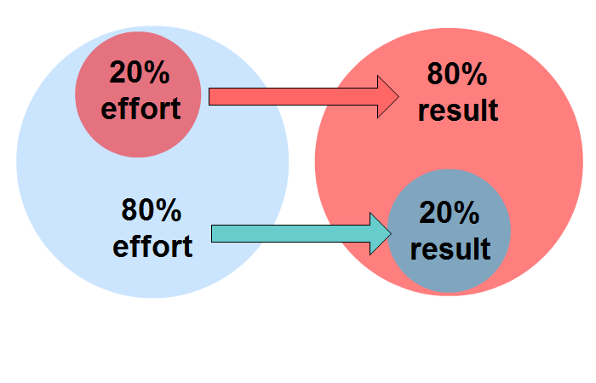



Slide 32
References
http://www.tutorialspoint.com/uml/uml_use_case_diagram.htm
http://gyan.fragnel.ac.in/~surve/OOAD/UCD/UCD_Types.html

